Slide 1
System Administration Warehouse Setup
WMS Guide

Slide 2
Table of Contents
Warehouse Options………………………………………………………………………………………………………..……………………….5
Release Mobile Locks & Release Exclusive Locks Options………………………………………………………..28
Sections.…………………………………………………………………..……………………………………………………………………………29
Mobile Equipment…….………………………..…………………………………………………………………………………..…………….35
Mobile Equipment Details………………….…………………………………………………………………………………..……………..48
Warehouse Searches………………………………………….………………………………………………………………..………………..52
Warehouse Searches Details……………………………………………………………………………………………..…………………..66
Hold Codes.…………………………………………………………………………………………………………..……………………………….70
Reasons.…………………………………………….…………………………………………………………………..………………………………78
Storage Rules.…………………………….…………………………………………………………………………..………………………….....86
Storage Rule Details.………………………………….…………………………………………………………..…………………………….101

Slide 3
Table of Contents
Container Types………………………………………………………………………………………………………..…………………………106
Container Selection Codes………………………………………………………………………………………..…………………………121
Container Selection Code Details………………………………………………………………………………..……………………….134
Stations…………………………………….………………………………………………………………………………..……………………….138
Station Devices…………………………………………………….……………………………………………………..……………………….155
Areas…………………………………………………….……………………………………………………………………..………………………163
Area Confirmations…………………………………………………….……………………………………………………..…………………184
WMS Users…………………………………………………….…………..………………………………………………..………………………193
Document Format Definitions for WMS………………..……………………………………………………..………………………195
Route Points………………………………………………………….……………………………………………………..………………………205

Slide 4
Table of Contents
Route Work…………………………………….…………………….……………………………………………………..………………………213
Route Move Instructions………………..…………………………………………………………………………..……………………….224
Routing Simulator…………………………………………….…………………………………………..……………………….228

Slide 5
Warehouse Options

Slide 6
Warehouse Options
The Warehouse Options resource includes parameters that are initially populated during the WMS installation procedure.
This resource contains the general information such as the material selection parameters, default values for customer and vendor returns, definition of automatic cycle counts, definition of several system-wide parameters, etc.
This resource is used to maintain the parameters established in the warehouse, create new warehouses in the database and Query the parameters defined in the warehouse options table.
Since multiple WMS warehouses may be set up in the same database, when launching this resource, you are only given the warehouse record tied to your session parameter.

Slide 7
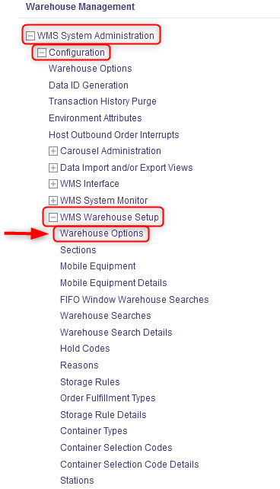
Warehouse Options
With a desktop computer, select the WMS System Administration resource.
Under WMS System Administration, click on Configuration.
Under Configuration, click on WMS Warehouse Setup.
Under WMS Warehouse Setup, click on Warehouse Options.

Slide 8
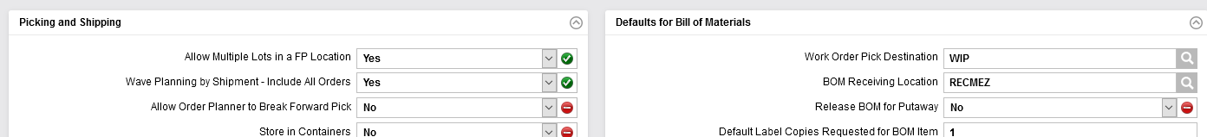
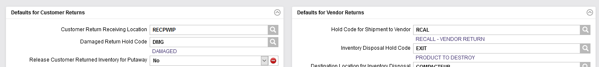
Warehouse Options
From the new window, six sections will appear: Ship From, Receiving, Picking and Shipping, Defaults for Bill of Materials, Defaults for Customer Returns and Defaults for Vendor Returns.

Slide 9
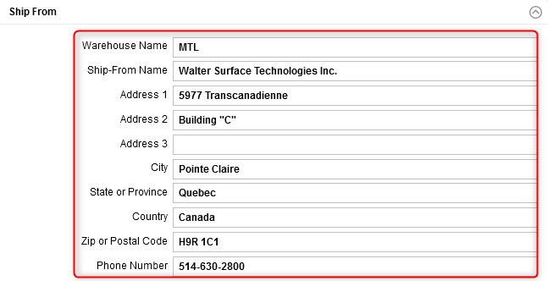
Warehouse Options
Complete the Ship From section for the fields shown below. An explanation of the fields is given in the next slide.

Slide 10
Warehouse Options
(Continued)
Field | Explanation
Warehouse Name | The name of the given warehouse.
Ship-From Name* | The company name
Address 1 | The ship-from's first line of address.
Address 2 | The ship-from's second line of address.
Address 3 | The ship-from's third line of address.
City* | The city in which the warehouse is located.
State or Province* | The state or province in which the warehouse is located.
Country* | The country in which the warehouse is located.
Zip or Postal Code* | The zip or postal code associated with the warehouse location.
Phone Number* | The warehouse's phone number.
*These fields will appear on all report, list, and label headers.

Slide 11
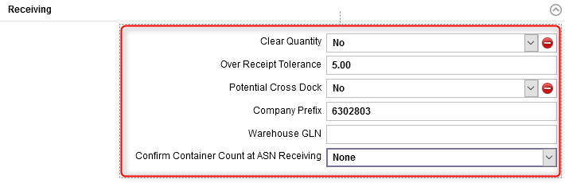
Warehouse Options
Complete the Receiving section for the fields shown below. An explanation of the fields is given in the next slides.

Slide 12
Warehouse Options
(Continued)
Field | Explanation
Clear Quantity | Affects inbound order receiving on a mobile computer: Yes indicates that the quantity to receive is hidden. In this case, when the cursor is moved to the Quantity field, the field will appear to be blank. If nothing is changed in that field, then when the cursor is moved to another field, the user is forced to enter a quantity. No indicates that the quantity to receive is displayed. In this case, when the cursor is moved to the Quantity field, the number is displayed without any trailing zeroes after the decimal point.
Over Receipt Tolerance | The percentage by which a receipt quantity may exceed the inbound order quantity.
Potential Cross Dock | Yes indicates that potential cross docking is enabled for this system. No indicates that potential cross docking is not enabled.

Slide 13
Warehouse Options
(Continued)
Field | Explanation
Company Prefix | This field is a unique number assigned to a company by GS1 US to serve as the foundation for generating GS1 identifiers (e.g. GTIN). This field is used in generating the UCC128 / SSCC-18 bar code when printing shipping labels for EDI customers.
Warehouse GLN | The Global Location Number (GLN) for the Ship From location of the warehouse set up in the warehouse options table.
Confirm Container Count at ASN Receiving | A flag that indicates whether or not the user must enter the quantity received during the ASN receiving process. None indicates that the user is not required to enter the quantity received and that the values displayed on the receipt are based on the ASN. Force indicates that the user must enter the quantity received. The quantity entered by the user is compared to the ASN to ensure that the values match. If the values do not match, an error message is displayed and the receipt is not completed. Optional indicates that the user may enter the quantity received or choose to skip this step. Similarly to the Force option, if the values entered do not match with the ASN, an error message is displayed and the receipt is not completed.

Slide 14
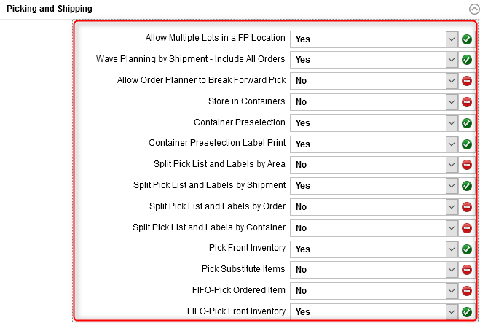
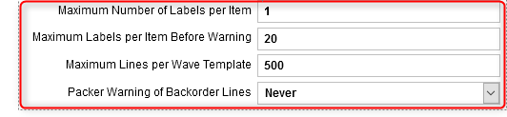
Warehouse Options
Complete the Picking and Shipping section for the fields shown below. An explanation of the fields is given in the next slides.

Slide 15
Warehouse Options
(Continued)
Field | Explanation
Allow Multiple Lots in a FP Location | No indicates that the system will not allow multiple lots in a forward pick location. Yes indicates that the system will allow multiple lots in a forward pick location.
Wave Planning by Shipment - Include All Orders | Yes indicates that while querying on an order, if other orders exist with the same shipment number, then display those also. No indicates that only the specific order queried upon should be retrieved, regardless of whether or not it is part of a multi-order shipment.
Allow Order Planner to Break Forward Pick | Yes indicates that material in a forward pick location can be broken when picking (or replenishing) from a forward pick location. No indicates that material in a forward pick location cannot be broken.
Store in Containers | Yes indicates that the storage logic will look for a suitable location for a non-transport container based on the container dimensions and the storage rule of the inventory found in the container. When this flag is set to Yes, the system does not perform a preverification for possible sources of replenishment. No indicates that the system does not store a non-transport container, nor will it search for inventory within any manually stored non-transport containers.

Slide 16
Warehouse Options
(Continued)
Field | Explanation
Container Preselection | This flag controls the ability to have the WMS preselect the optimal shipping container size into which an outbound order is picked and packed. Yes indicates that the pick container preselection algorithm is implemented on a system-wide basis. If set to Yes, the system will preselect the optimal container type to be used for order picking based on the table-driven rules defined in the container selection tables. No indicates that the pick container preselection algorithm is not implemented.
Container Preselection Label Print | A flag that indicates whether or not CPRE labels will be printed. If Yes is selected, the the CPRE labels will be printed. The value of this flag depends on the value of the Container Preselection flag. If the Container Preselection flag is set to No, this flag cannot be set to Yes. If the Container Preselection flag is set to Yes, this flag may be set to either Yes or No.

Slide 17
Warehouse Options
(Continued)
Field | Explanation
Split Pick List and Labels by Area | When releasing a wave via the Wave Management resource, select Yes to indicate that you wish to generate the pick list and pick labels by area for the orders selected. Otherwise, select No.
Split Pick List and Labels by Shipment | When releasing a wave via the Wave Management resource, select Yes to indicate that you wish to generate the pick list and pick labels by shipment for the orders selected. Otherwise, select No.
Split Pick List and Labels by Order | When releasing a wave via the Wave Management resource, select Yes to indicate that you wish to generate the pick list and pick labels by order for the orders selected. Otherwise, select No.
Split Pick List and Labels by Container | When releasing a wave via the Wave Management resource, select Yes to indicate that you wish to generate the pick list and pick labels by container for the orders selected. Otherwise, select No. If the Split Pick List and Labels by Area field was also set to Yes, the pick list or pick labels generated will automatically be generated separately for each container and area combination.

Slide 18
Warehouse Options
(Continued)
Field | Explanation
Pick Front Inventory | This applicable when inventory is found in a FIFO or LIFO location. Yes indicates that the order scheduler will look for the front inventory in a location after it has found valid inventory to use in that location. No indicates that the order scheduler will not look for the front inventory. This will improve the speed in systems not concerned with picking from the front of locations. If this flag is set to Yes, then when the WMS selects an inventory record during the inventory selection process based on the warehouse search path, the system will additionally sort all of the item's inventory records within the chosen location by last move date and reselect a new inventory record within the location. This flag can be overruled if an item's Apply Forward Pick FEFO Logic flag is set to Yes.
Pick Substitute Items | This is used to find inventory quantities after cycling through the search method sequence or when the item or package details are inadequate to fill the demand. Yes indicates that picking of substitute material is allowed. No indicates that the order scheduler will not look for substitutes. This flag can be overruled if an item's Apply Forward Pick FEFO Logic flag is set to Yes.

Slide 19
Warehouse Options
(Continued)
Field | Explanation
FIFO-Pick Ordered Item | This is used in conjunction with the FIFO Window Warehouse Search resource to ensure that inventory found in the search matches the original item. This flag is necessary when searching for substitute inventory. Yes indicates that the order scheduler will look for the original order line item when looking at the FIFO Pick Window for a substitute item. No indicates that the order scheduler will not look for the original order line item/package code.
FIFO-Pick Front Inventory | This is used by the FIFO window warehouse search logic to find inventory that is X days older than the selected inventory. This triggers the front inventory logic. Yes indicates that the order scheduler will look for the oldest front inventory in a location, after it has found valid older inventory to use in that location. No indicates that the order scheduler will not look for the oldest front inventory. The system will allocate against the front-most unit load unless it has a receipt date and time which is more than N days older then the oldest unit load within the storage location.

Slide 20
Warehouse Options
(Continued)
Field | Explanation
Maximum Number of Labels per Item | The number of pick labels printed for an item, tag, and UOM combination.
Maximum Labels per Item Before Warning | The maximum number of labels for a single item for each order line. This is used by the Outbound Order Planning resource. When the maximum is exceeded, then prior to the wave's release, a warning message is displayed giving the user the option to continue or to change the settings.
Maximum Lines per Wave Template | The default value for the number of detail lines that are allowed to appear in a single wave. This field determines the maximum number of order lines allowed.
Packer Warning of Backorder Lines | A flag that controls the error message displayed in the Ready to Ship column of the Shipping Activities resource. Never indicates that a warning message is not displayed when there are backordered lines for any order tied to the shipment. Always indicates that an error message which warns the user that backordered lines exist for any order tied to the shipment is displayed.

Slide 21
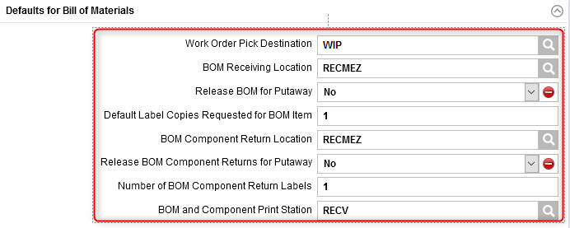
Warehouse Options
Complete the Defaults for Bill of Materials section for the fields shown below. An explanation of the fields is given in the next slide.

Slide 22
Warehouse Options
(Continued)
Field | Explanation
Work Order Pick Destination | All work orders are assigned this location as the initial pick destination. It may be overridden in the Outbound Order Planning resource.
BOM Receiving Location | The receiving location for work order bills of material (BOM) received.
Release BOM for Putaway | Select Yes to indicate that work order BOM shall be released for putaway. Otherwise, select No.
Default Label Copies Requested for BOM Item | The default number of copies presented when requesting labels for work order BOM components.
BOM Component Return Location | The return location for unused work order components.
Release BOM Component Returns for Putaway | Select Yes to indicate that unused work order component returns shall be released for putaway. Otherwise, select No. A value of No indicates that unused work order component returns shall not be released for putaway.
Number of BOM Component Return Labels | The default number of copies presented when requesting labels for unused work order components.
BOM and Component Print Station | The station to which any required paperwork or labels for BOM item or BOM printing station component returns are to be directed.

Slide 23
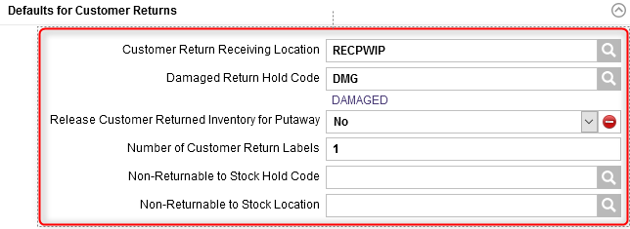
Warehouse Options
Complete the Defaults for Customer Returns section for the fields shown below. An explanation of the fields is given in the next slide.

Slide 24
Warehouse Options
(Continued)
Field | Explanation
Customer Return Receiving Location | This location identifies the designated receiving location for inventory related to a customer return.
Damaged Return Hold Code | This hold code is automatically assigned to damaged inventory related to a customer return.
Release Customer Returned Inventory for Putaway | This field is used if the release for putaway has not been specified on the DMS. Select Yes to indicate that customer return items received should be released for putaway after the receipt has been processed. Otherwise, select No.
Number of Customer Return Labels | The number of labels to be printed when receiving inventory related to a customer return. This field is used if the number of labels has not been specified on the DMS.
Non-Returnable to Stock Hold Code | The non-returnable to stock hold code in the Express Returns resource. When used, it will be applied to any item identified as a non-returnable to stock item in the items table.
Non-Returnable to Stock Location | The non-returnable to stock disposal location. When used, it will be populated as the final destination location for the item when processing an Express Returns. The product will be stored directly in that location when the Express Returns is released. Any location type can be used for the disposal location with the exception of a hold or an exit location.

Slide 25
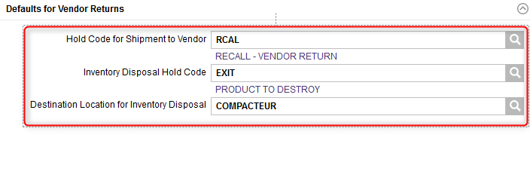
Warehouse Options
Complete the Defaults for Vendor Returns section for the fields shown below. An explanation of the fields is given in the next slide.

Slide 26
Warehouse Options
(Continued)
Field | Explanation
Hold Code for Shipment to Vendor | This hold code is used to designate damaged inventory (tags) that are destined for disposal (i.e. shipped back to the vendor). This is used to indicate how repaired inventory related to a vendor return is to be processed.
Inventory Disposal Hold Code | This hold code is used to designate damaged inventory (tags) destined for disposal. This hold code is only used for vendor returns.This is used to indicate how repaired inventory related to a vendor return is to be processed.
Destination Location for Inventory Disposal | The location to which inventory is taken for disposal. An exit location that identifies the pick destination. This location only applies to items included in a vendor return with a specific hold code.

Slide 27
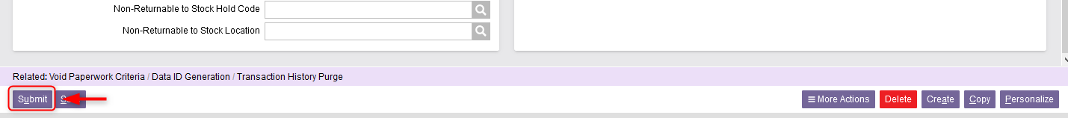
Warehouse Options
Once all the required fields in the sections have been completed, click Submit.
Click Close to exit the Warehouse Options resource.

Slide 28
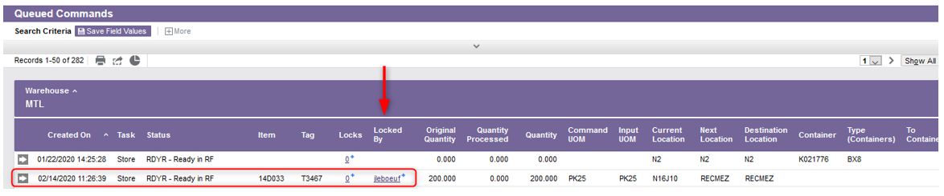
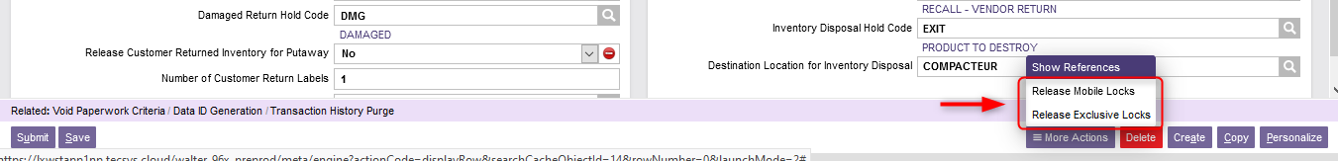
Warehouse Options
Additional Note – Release Mobile Locks & Release Exclusive Locks. If you see that a transaction is blocked in the WMS (using the Queued Commands resource), you can unblock that transaction in the Warehouse Options resource using one of the following two buttons: either Release Mobile Locks to unblock the transaction on a device mobile or Release Exclusive Locks for a desktop computer.

Slide 29
Sections

Slide 30
Sections
The Sections resource is used to add, modify, copy, and delete the records in the sections table and query the records in the sections table.
A section may be physical or logical as defined within the WMS. A section is defined in the WMS as a logical attribute of some location or group of locations.
Sections are established primarily for the inventory selection process for selecting inventory to fulfill outbound order lines and forward pick location replenishments.
More than one section is required only if the inventory selection process should consider certain groups of locations as having a higher priority over others.

Slide 31
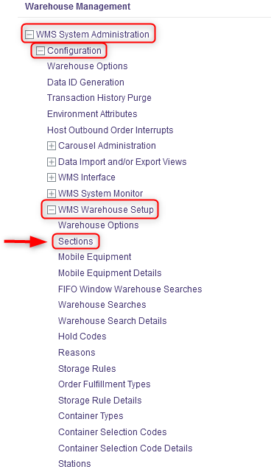
Sections
With a desktop computer, select the WMS System Administration resource.
Under WMS System Administration, click on Configuration.
Under Configuration, click on WMS Warehouse Setup.
Under WMS Warehouse Setup, click on Sections.

Slide 32
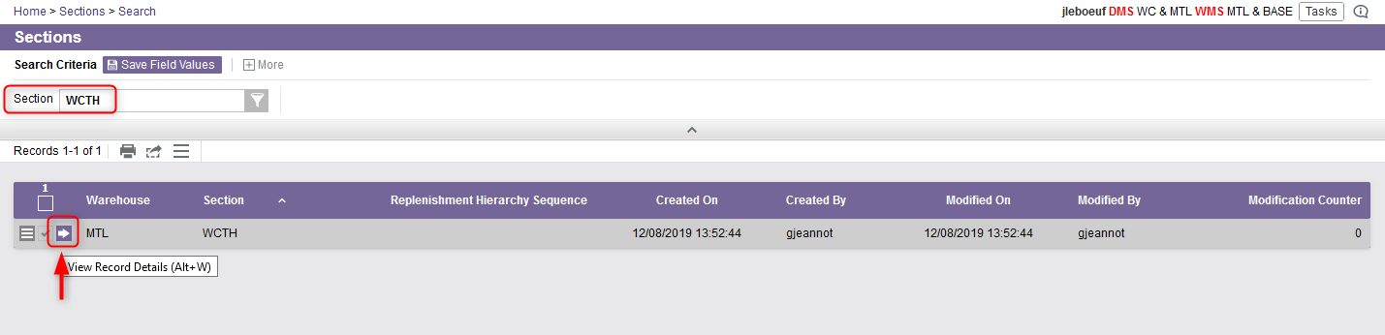
Sections
From the new window, the different sections of the warehouse will be listed.
If required, perform a search to retrieve the section you wish to update and click on View Record Details.

Slide 33
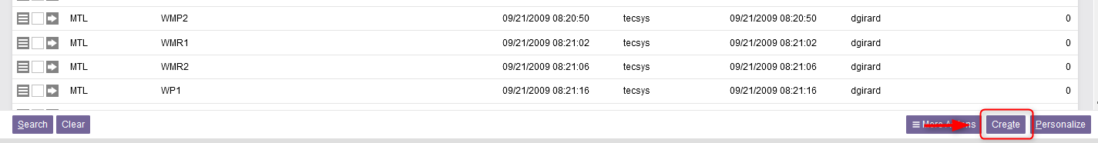
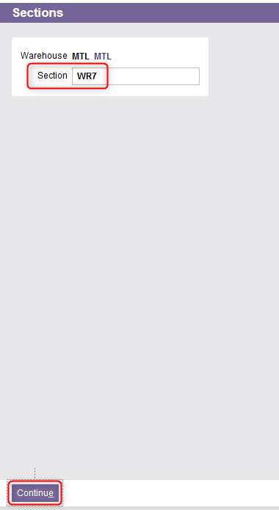
Sections
You also have the option to create a new section. To do this, click on Create at the bottom right of your screen.
From the new window, enter the section name.
Click Continue.

Slide 34
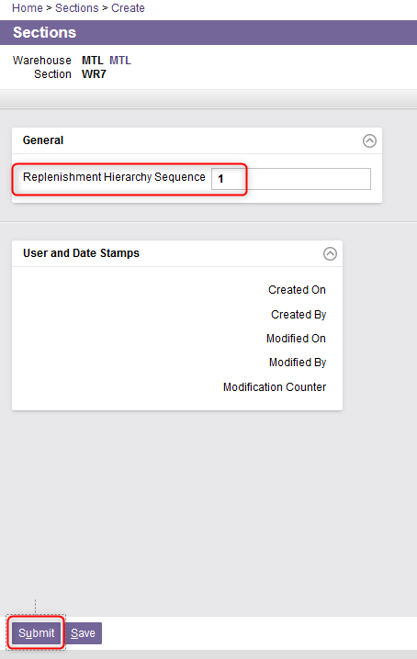
Sections
Whether you have chosen to update a section or create a new one, a new Sections window will appear. From this window, enter or update the Replenishment Hierarchy Sequence field if needed.
This field is optional.
This field corresponds to the replenishment hierarchy sequence of the section.
This is used by the replenishment logic when replenishing a forward pick location from another forward pick location where the UOM configurations for both locations are the same. This is used to prevent a replenishment loop of an FP to another and then back again.
Then Click Submit.

Slide 35
Mobile Equipment

Slide 36
Mobile Equipment
The Mobile Equipment resource is used to add, modify, and delete the records in the mobile equipment table and query the records in the mobile equipment table.
The mobile equipment type refers to equipment a user actually uses on the floor, such as a turret truck or a forklift.
Each mobile equipment type is assigned one or more location classes which define the locations the equipment type may access.
When a user signs onto a mobile computer, the user specifies the equipment type being operated.

Slide 37
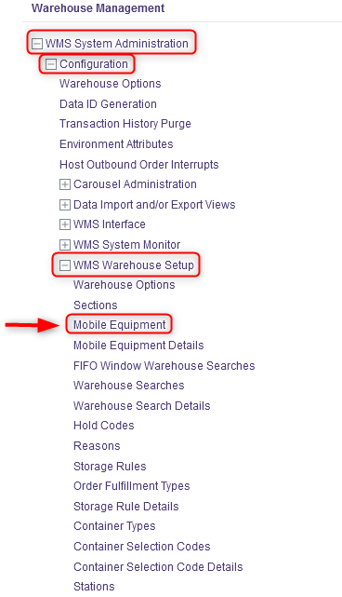
Mobile Equipment
With a desktop computer, select the WMS System Administration resource.
Under WMS System Administration, click on Configuration.
Under Configuration, click on WMS Warehouse Setup.
Under WMS Warehouse Setup, click on Mobile Equipment.

Slide 38
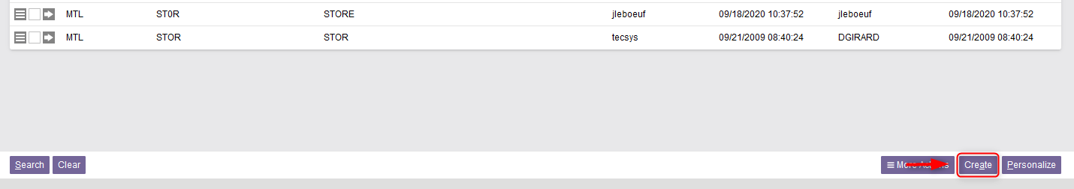
Mobile Equipment
In the new window, the different mobile equipment already configured in the WMS will be listed.
If you want to create a mobile equipment, do this:
6.1 Click on Create at the bottom right of your screen.

Slide 39
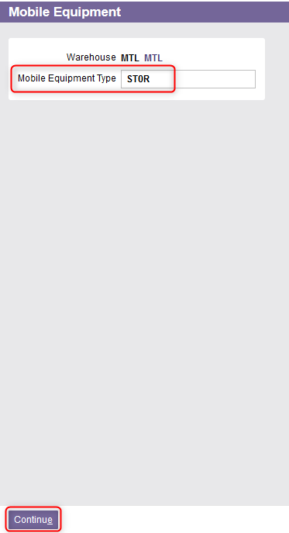
Mobile Equipment
6.2 From the new window, enter the name of the mobile equipment type.
6.3 Click Continue.

Slide 40
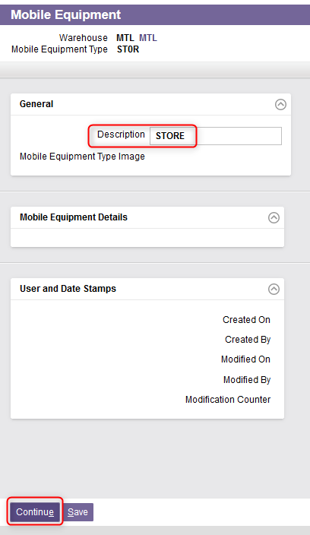
Mobile Equipment
6.4 A new window will appear. Enter a description of the mobile equipment.
6.5 Click on Continue.

Slide 41
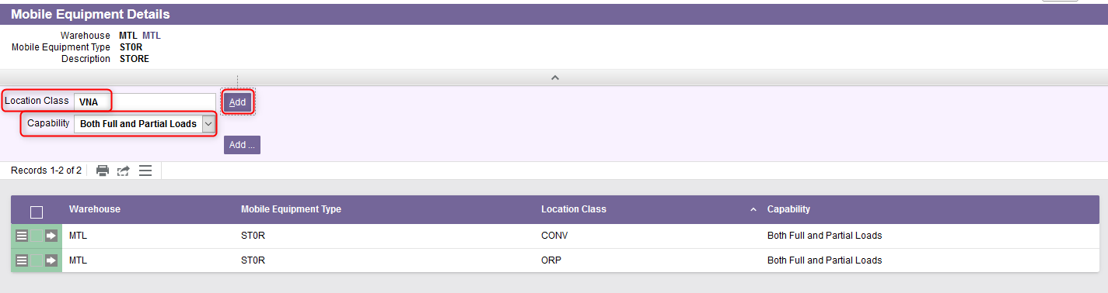
Mobile Equipment
6.6 You will be automatically redirected to the Mobile Equipment Details view. Enter as many location classes as you want by:
Entering the Location Class,
Modifying the Capability if necessary,
Clicking on Add.
An explanation of the fields is given in the next slide.

Slide 42
Mobile Equipment
6.6 (Continued)
Field | Explanation
Location Class | Each mobile equipment type is assigned one or more location classes which define the locations the equipment type may access. The location class refers to the type of storage unit. Each location is assigned a location class.
Capability | Different options are available. At a specific class of location: Full Loads indicates that a full load can be handled for a mobile equipment type, Partial Loads indicates that a partial load can be handled for a mobile equipment type, Both Full and Partial Loads indicates that either a full load or a partial load can be handled for a mobile equipment type.

Slide 43
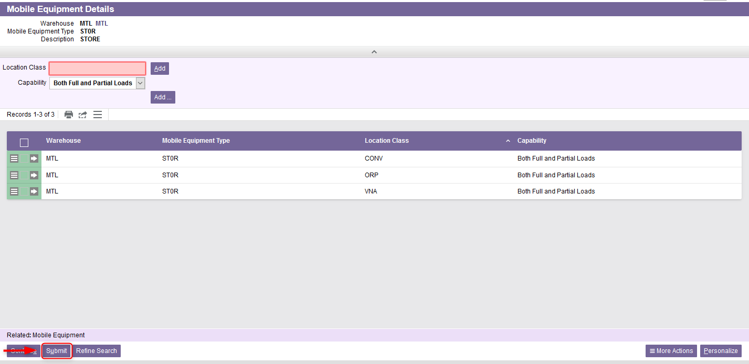
Mobile Equipment
6.7 Once all location classes properly added, click on Submit.

Slide 44
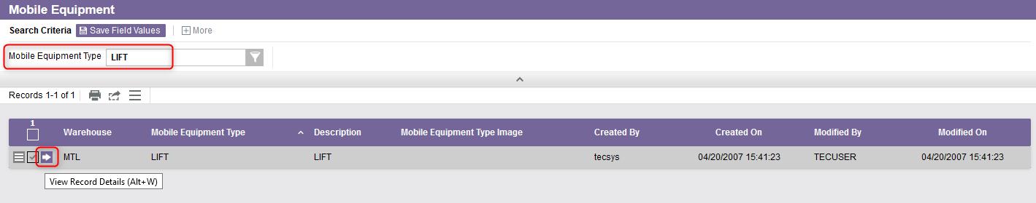
Mobile Equipment
If you want to update a mobile equipment, do this:
7.1 Perform a search to retrieve the mobile equipment you wish to update and click on View Record Details.

Slide 45
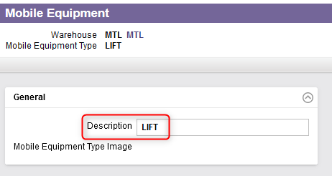
Mobile Equipment
7.2 In the General section, update the description if need be.

Slide 46
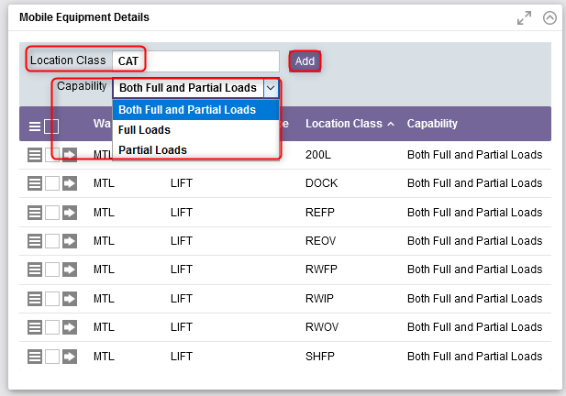
Mobile Equipment
7.3 In the Mobile Equipment Details section, the location classes already associated with the mobile equipment will be listed. You can add more if necessary:
Enter the Location Class,
Modify the Capability if necessary,
Click on Add.

Slide 47
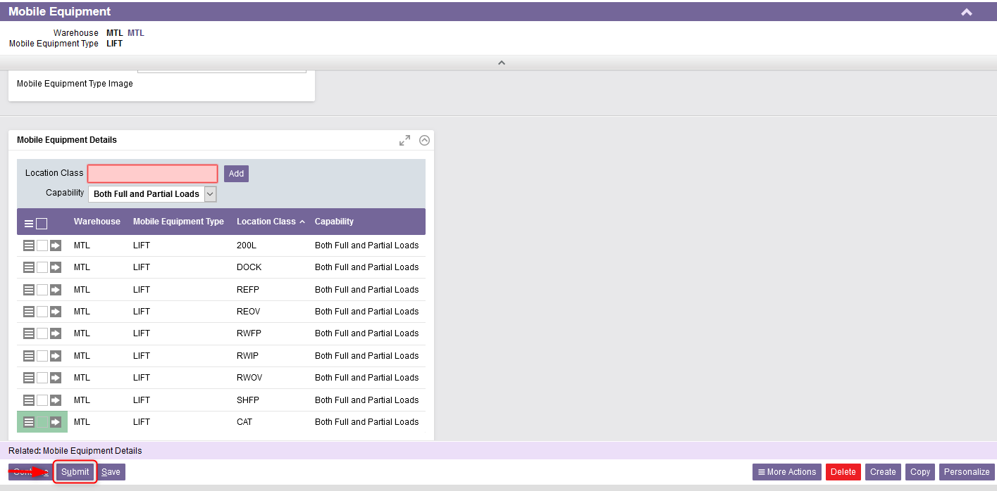
Mobile Equipment
7.4 Once all location classes properly added, click on Submit.

Slide 48
Mobile Equipment Details

Slide 49
Mobile Equipment Details
The Mobile Equipment Details resource is used to add, modify, and delete the records in the mobile equipment details table and query the records in the mobile equipment details table.
When launched directly from the portal, this view can be used to edit existing records via Excel or the search results grid. In addition, record-level actions may be executed.
However, the Details page does not allow editing.

Slide 50
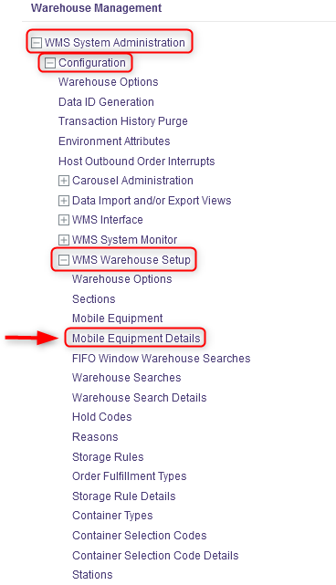
Mobile Equipment Details
With a desktop computer, select the WMS System Administration resource.
Under WMS System Administration, click on Configuration.
Under Configuration, click on WMS Warehouse Setup.
Under WMS Warehouse Setup, click on Mobile Equipment Details.

Slide 51
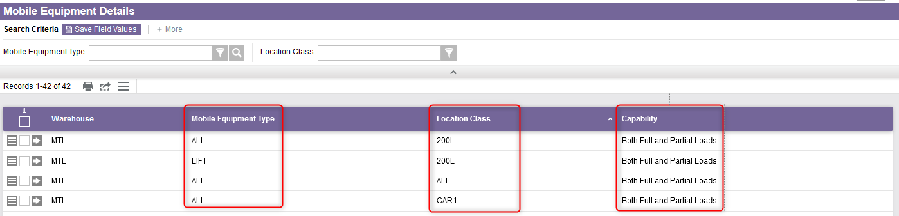
Mobile Equipment Details
The Mobile Equipment Details view will show you all mobile equipment types existing in the WMS as well as their associated locations classes.
Location class associated with the mobile equipment type which defines the location the equipment type may access. It refers to the type of storage unit.
This indicates either a full load, a partial load or both can be handled for this mobile equipment type at a specific class of location.
Type of mobile equipment a user needs to perform tasks.

Slide 52
Warehouse Searches

Slide 53
Warehouse Searches
The Warehouse Searches resource is used to add, modify, copy, and delete the records in the warehouse searches table and query the records in the warehouse searches table.
Warehouse search paths are used to select inventory that matches line items in outbound orders, or to select inventory to be used in replenishment commands.
A set of rules can be assigned to a single warehouse search path. Each rule is assigned a priority, indicating the sequence in which the rule is to be examined. The search will attempt to locate inventory one rule at a time in the section specified by the rule and with the search method specified.

Slide 54
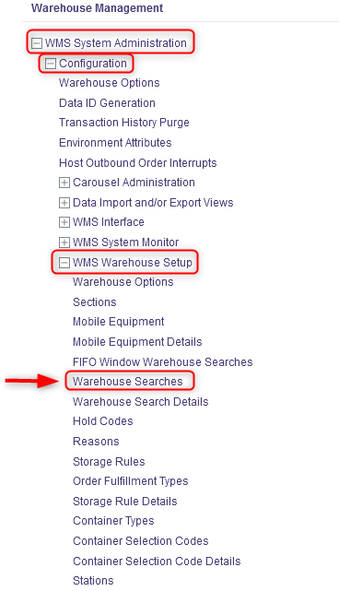
Warehouse Searches
With a desktop computer, select the WMS System Administration resource.
Under WMS System Administration, click on Configuration.
Under Configuration, click on WMS Warehouse Setup.
Under WMS Warehouse Setup, click on Warehouse Searches.

Slide 55
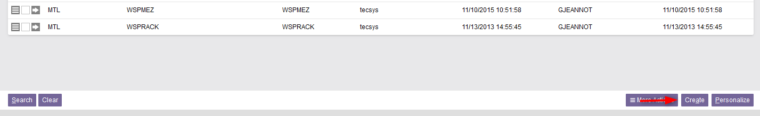
Warehouse Searches
From the new window, the different warehouse searches already configured in the WMS will be listed.
If you want to create a warehouse search path, do this:
6.1 Click on Create at the bottom right of your screen.

Slide 56
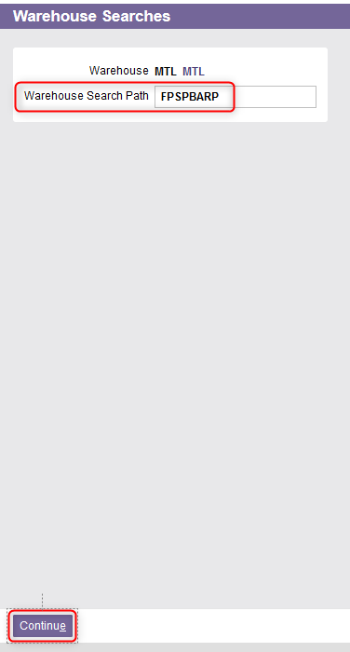
Warehouse Searches
6.2 From the new window, enter the name of the Warehouse Search Path.
6.3 Click Continue.

Slide 57
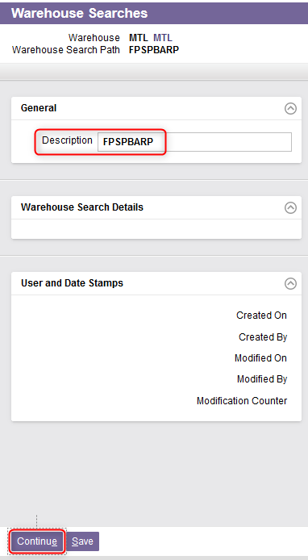
Warehouse Searches
6.4 A new window will appear. Enter a description of the warehouse search path.
6.5 Click on Continue.

Slide 58
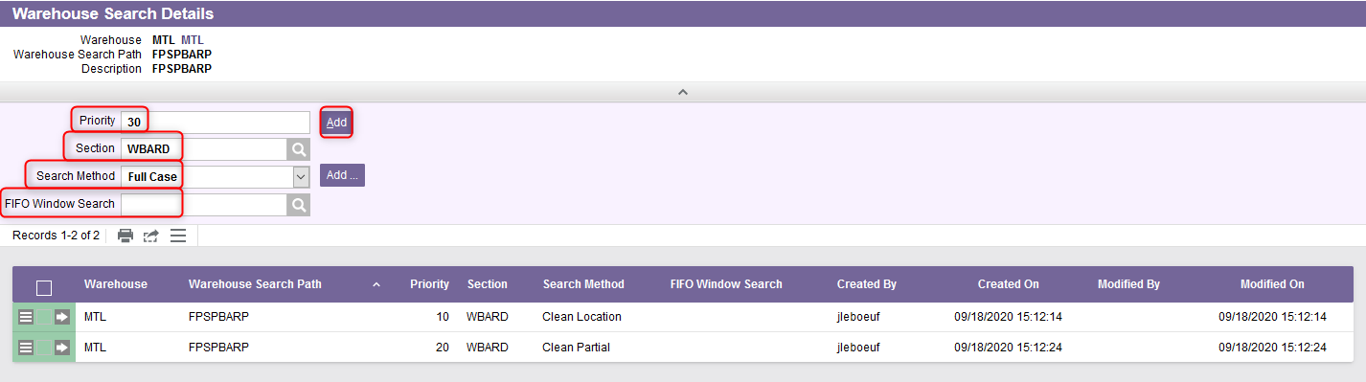
Warehouse Searches
6.6 You will be automatically redirected to the Warehouse Search Details view. Enter as many search methods as you want by:
Entering a Priority,
Entering the section,
Selecting the search method from the drop-down menu,
Adding a FIFO window search if required,
An explanation of the fields is given in the next slides.
Clicking on Add.

Slide 59
Warehouse Searches
6.6 (Continued)
Field | Explanation
Search Method | Different options are available. At a specific class of location: Clean Location indicates that the WMS will search through locations with partial loads in the specified section to clean up locations. The WMS will pick inventory from the location with the least inventory. Note that inventory from a full load may be allocated. Clean Partial indicates that the WMS will search through locations with partial loads in the specified section to clean up partial loads. The WMS will pick the partial load only if the required quantity is equal to or greater than the quantity on the partial load. The smallest partial will be picked first. Select only inventory that will empty a partial load. Full Case indicates that the WMS will search the specified section for full cases. Full Load indicates that the WMS will search the specified section for full loads. Forward Pick indicates that the WMS will search the specified section for inventory in forward pick locations. Partial indicates that the WMS will search the specified section for partial loads.

Slide 60
Warehouse Searches
6.6 (Continued)
Field | Explanation
Priority | This corresponds to the priority of the displayed entry within the search code, when the system selects inventory that matches line items in outbound orders, or to select inventory to be used in replenishment commands. Priority 1 represents the first choice for this warehouse search rule.
Section | This corresponds to the warehouse section code for the locations to search. Locations are grouped into warehouse sections for inventory selection.
FIFO Window Search | If a FIFO search is specified here, the system will execute a second search for any product that exceeds the FIFO Window field in the Items resource. The FIFO window search is only executed if some product is found as a result of the warehouse search path specified here.

Slide 61
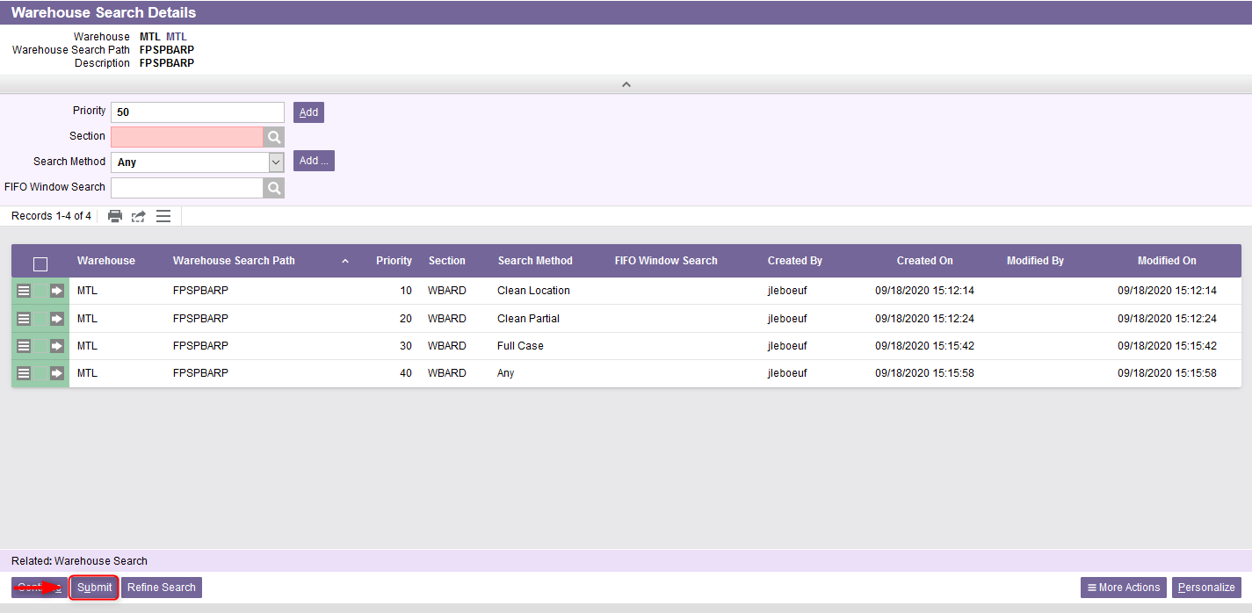
Warehouse Searches
6.7 Once all search methods properly added, click on Submit.

Slide 62
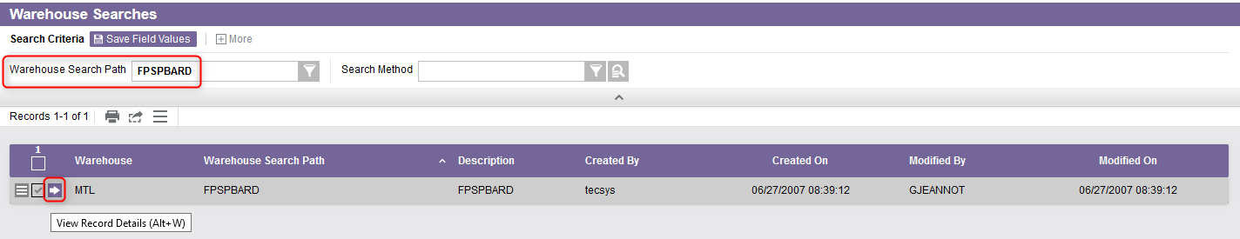
Warehouse Searches
If you want to update a warehouse search path, do this:
7.1 Perform a search to retrieve the warehouse search path you wish to update and click on View Record Details.

Slide 63
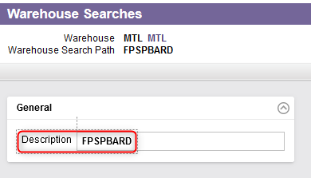
Warehouse Searches
7.2 In the General section, update the description if need be.

Slide 64
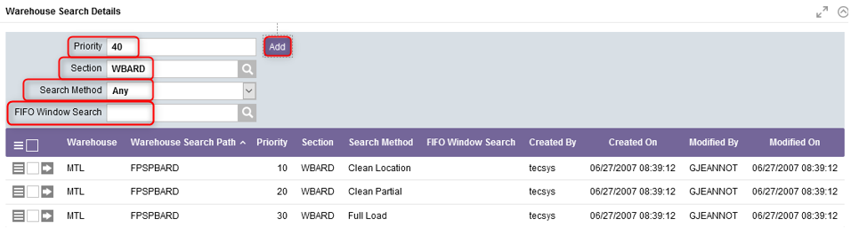
Warehouse Searches
7.3 In the Warehouse Search Details section, the search methods already associated with the warehouse search path will be listed. You can add more if necessary:
Enter a Priority,
Enter the section,
Select the search method from the drop-down menu,
Add a FIFO window search if required,
Click on Add.

Slide 65
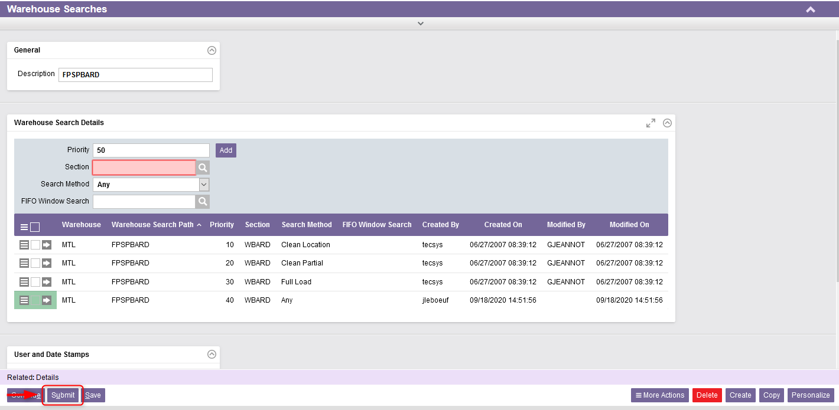
Warehouse Searches
7.4 Once all search methods properly added, click on Submit.

Slide 66
Warehouse Searches Details

Slide 67
Warehouse Searches Details
The Warehouse Searches Details resource is used to view to add, modify, delete, and query warehouse search details.
When launched directly from the portal, this view can be used to edit existing records via Excel or the search results grid. In addition, record-level actions may be executed.
However, the Details page does not allow editing.

Slide 68
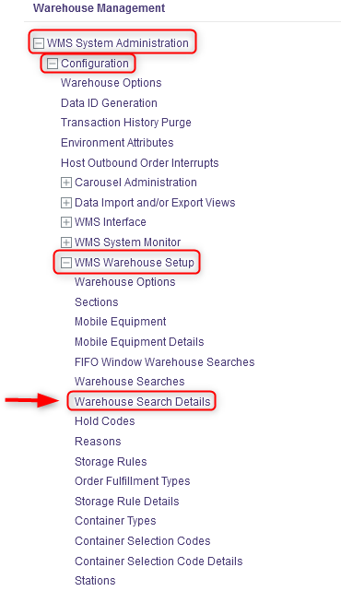
Warehouse Searches Details
With a desktop computer, select the WMS System Administration resource.
Under WMS System Administration, click on Configuration.
Under Configuration, click on WMS Warehouse Setup.
Under WMS Warehouse Setup, click on Warehouse Search Details.

Slide 69
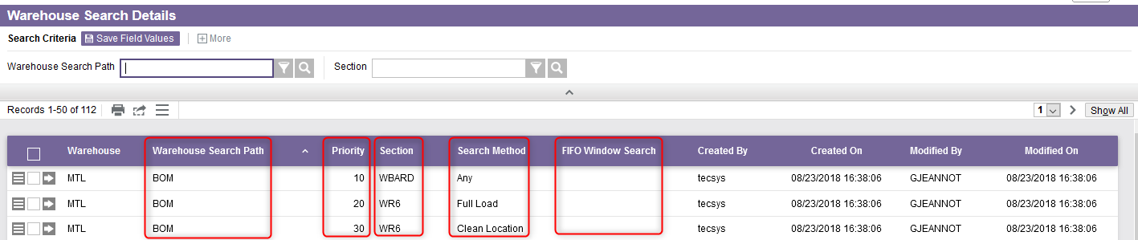
Warehouse Searches Details
The Warehouse Searches Details view will show you all warehouse search path existing in the WMS as well as their associated search method and any relevant information.
The warehouse search path identifies the header record and is unique across all records.
Search method associated with the warehouse search path which defines how the system will week inventory within the section.
If a value is specified here, the system will execute a second search for any product that exceeds the FIFO Window field in the Items resource.
Corresponds to the priority given to the search method.
Warehouse section code for the location to search.

Slide 70
Hold Codes

Slide 71
Hold Codes
The Hold Codes resource is used to add, modify, copy, delete the records in the hold codes table and to query the records in the hold codes table.
Hold codes are used to differentiate inventory and to keep separate from similar inventory, generally for the purpose of disposal, return to the vendor, testing, or inspection purposes. All inventory with a hold code will not be selected for outbound orders.
Inventory assigned a hold code will only use storage rules defined in the storage rule details table. These rules are defined for that specific hold code and will only be selected in the inventory selection algorithm for line items that request inventory with that specific hold code.

Slide 72
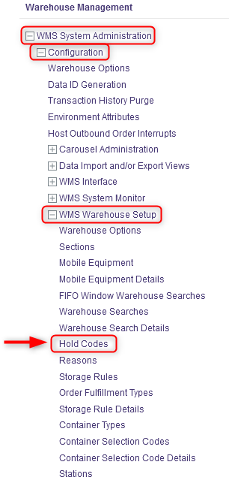
Hold Codes
With a desktop computer, select the WMS System Administration resource.
Under WMS System Administration, click on Configuration.
Under Configuration, click on WMS Warehouse Setup.
Under WMS Warehouse Setup, click on Hold Codes.

Slide 73
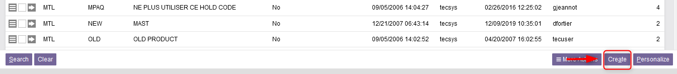
Hold Codes
In the new window, the different hold codes already configured in the WMS will be listed.
If you want to create a hold code, do this:
6.1 Click on Create at the bottom right of your screen.

Slide 74
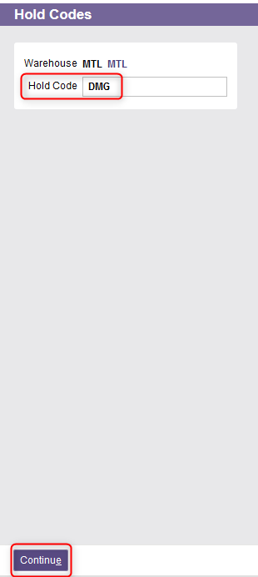
Hold Codes
6.2 From the new window, enter the name of the hold code.
6.3 Click Continue.

Slide 75
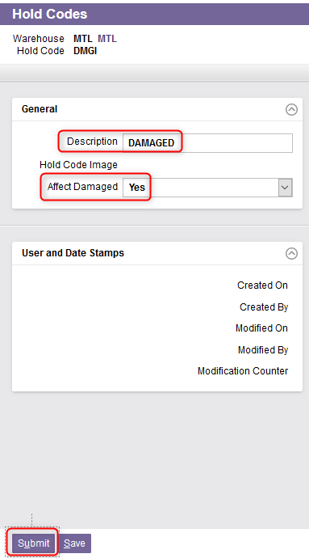
Hold Codes
6.4 A new window will appear. Enter a description of the hold code.
6.5 Indicate Yes or No in the Affect Damaged field.
Yes indicates that the inventory is damaged and will either be disposed of or returned to the vendor. If Yes is selected, the inventory for this hold code will be deducted from the on-hand inventory in the DMS.
No indicates that the inventory is on hold and will be tested or inspected.
6.6 Click Submit.

Slide 76
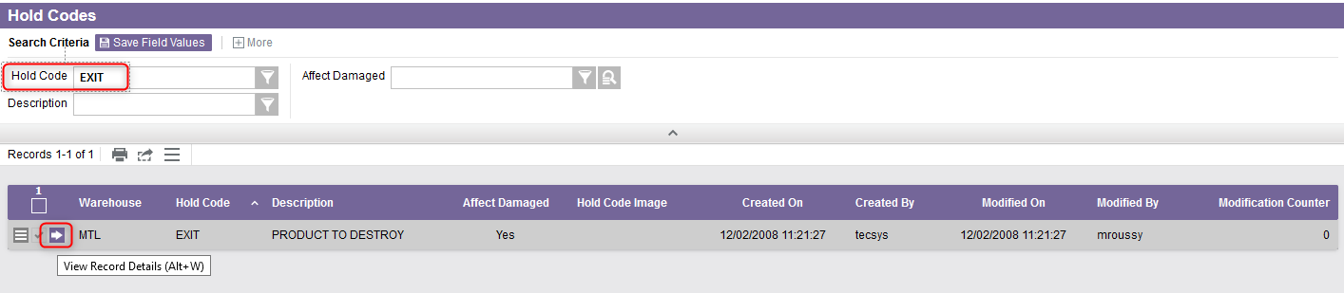
Hold Codes
If you want to update a hold code, do this:
7.1 Perform a search to retrieve the hold code you wish to update and click
on View Record Details.

Slide 77
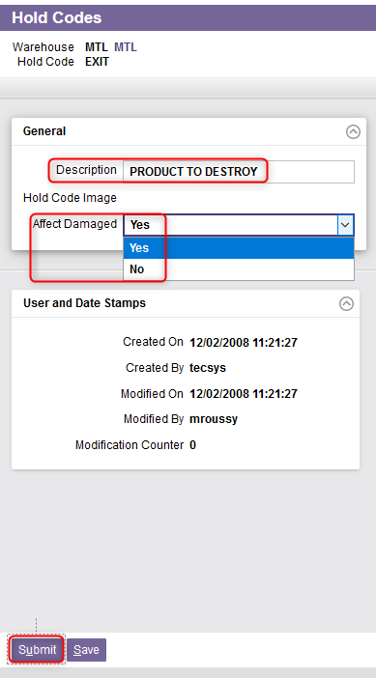
Hold Codes
7.2 In the General section, if necessary:
Update the description,
Update the Affect Damaged field. Refer to the slide 75 for more details regarding this field.
7.3 Once all the required fields properly updated, click on Submit.

Slide 78
Reasons

Slide 79
Reasons
The Reasons resource is used to add, modify, copy, delete the records in the reasons table and to query the records in the reasons table.
Reason codes are standardized explanations of various actions a user may perform.
Reason codes are required in performing any inventory adjustment via either the Inventory Adjustments, Inventory Status Modification, or Inventory Relocation resources and may be used during the receiving process.

Slide 80
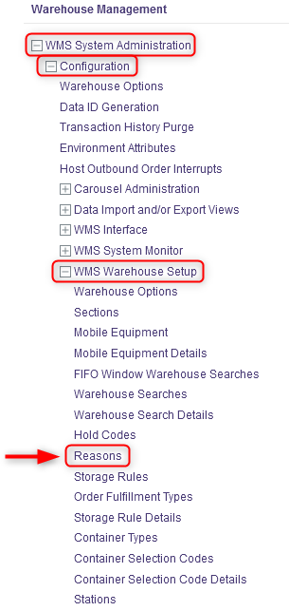
Reasons
With a desktop computer, select the WMS System Administration resource.
Under WMS System Administration, click on Configuration.
Under Configuration, click on WMS Warehouse Setup.
Under WMS Warehouse Setup, click on Reasons.

Slide 81
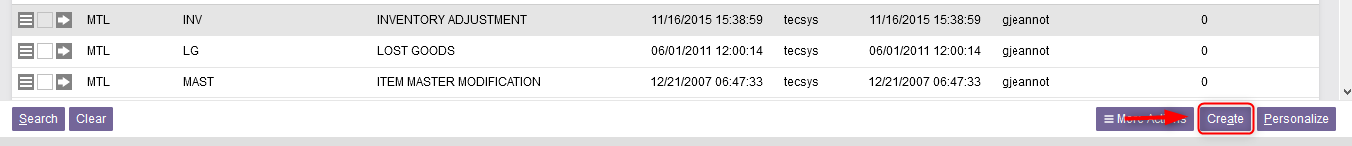
Reasons
From the new window, the existing reasons code already configured in the WMS will be listed.
If you want to create a reason code, do this:
6.1 Click on Create at the bottom right of your screen.

Slide 82

Reasons
6.2 From the new window, enter the name of the reason code.
6.3 Click Continue.

Slide 83

Reasons
6.4 A new window will appear. Enter a description of the reason code.
6.5 Click Submit.

Slide 84

Reasons
If you want to update a reason code, do this:
7.1 Perform a search to retrieve the reason code you wish to update and click
on View Record Details.

Slide 85

Reasons
7.2 In the General section, update the description of the reason if necessary.
7.3 Once the description field properly modified, click Submit.

Slide 86
Storage Rules

Slide 87
Storage Rules
The Storage Rules resource is used to add, modify, copy, delete the records in the storage rules table and to query the records in the storage rules table.
Storage rules specify how the system stores received inventory into a storage location.
Storage rules are also used to find storage locations during inventory moves.
Note that the items received with an assigned hold code defined in the Hold Codes resource will not use any part of the storage rule that does not specify that hold code.

Slide 88

Storage Rules
With a desktop computer, select the WMS System Administration resource.
Under WMS System Administration, click on Configuration.
Under Configuration, click on WMS Warehouse Setup.
Under WMS Warehouse Setup, click on Storage Rules.

Slide 89

Storage Rules
From the new window, the different storage rules already configured in the WMS will be listed.
If you want to create a new storage rule, do this:
6.1 Click on Create at the bottom right of your screen.

Slide 90

Storage Rules
6.2 A new window will appear. Enter the name of the storage rule.
6.3 Click Continue.

Slide 91

Storage Rules
6.4 A new window will appear. Enter a description for the storage rule.
6.5 Click Continue.

Slide 92

Storage Rules
6.6 You will be automatically redirected to the Storage Rule Details view. Enter as many rules as you want by entering/selecting :
A consolidation rule,
A zone,
A search rule,
A quantity rule,
A hold code (if applicable)
A priority
An explanation of the fields is given in the next slides.
Then click on Add.

Slide 93
Storage Rules
6.6 (Continued)
Field | Explanation
Storage Rule | The unique storage rule identifier for the record. Each rule may consist of several entries, which are evaluated in order of priority.
Consolidation Rule | Different options are available: Always Consolidate with Same Item indicates that the location to be selected through the storage rule must already contain a product of the same item. The location's capacity and dimensions will be ignored and the inventory will be forced to that location. Consolidate with Same Item indicates that the location to be selected through the storage rule must already contain product of the same item. Find Empty Locations indicates that the location to be selected through the storage rule is currently empty. Mix with Other Items indicates that the location to be selected through the storage rule is not empty and may contain product of a different item.

Slide 94
Storage Rules
6.6 (Continued)
Field | Explanation
Search Rule | Different options are available: By Storage Sequence indicates that the search should be in order of the location's storage sequence. By Capacity indicates that the search should be in order of the location's cube capacity, and then in order of the location's storage sequence. This field is maintainable when the Consolidation Rule is set to Find Empty Locations. Otherwise, the default value is set to By Storage Sequence and it is not maintainable.
Zone | The zone used to select a location in which the inventory is to be stored. The system will examine locations in that zone in order of store sequence.
Priority | The priority of this record within the storage rule. Each record in a storage rule is evaluated in order of priority, from lowest to highest.
Hold Code | The hold code of a full or partial load. This is used to provide a means to identify inventory that is to be kept separate from similar inventory.

Slide 95
Storage Rules
6.6 (Continued)
Field | Explanation
Quantity Rule | Different options are available: Use Individual Receipt Quantity indicates that the individual receipt quantity should be used in all of the storage logic calculations. This assumes that the full quantity received for a receipt is normally totaled and recorded in a single entry and/or that the inbound order line expected quantities are not always completely filled within a single receipt. Use Total Expected Quantity indicates that the item's total expected receipt quantity should be used in all of the storage logic calculations. The total expected receipt quantity is calculated as the total quantity ordered minus total completed quantity of all inbound order lines in the receipt for the item to be stored.

Slide 96

Storage Rules
6.7 Once all consolidation rules properly added, click on Submit.

Slide 97

Storage Rules
If you want to update a storage rule, do this:
7.1 Perform a search to retrieve the storage rule you wish to update and click on View Record Details.

Slide 98

Storage Rules
7.2 In the General section, update the description if need be.

Slide 99

Storage Rules
7.3 In the Storage Rule Details section, the consolidation rules already associated with the storage rule will be listed. You can add more if necessary:
Select a consolidation rule,
Enter a zone,
Select a search rule,
Select a quantity rule
Enter a hold code (if applicable)
Enter the priority
Then click on Add.

Slide 100

Storage Rules
7.4 Once all consolidation rules properly added, click on Submit.

Slide 101
Storage Rules Details

Slide 102
Storage Rules Details
This resource is used to add, modify, delete the records in the storage rule details table and to query the records in the storage rule details table.
When launched directly from the portal, this view can be used to edit existing records via Excel or the search results grid. In addition, record-level actions may be executed.
However, the Details page does not allow editing.

Slide 103

Storage Rules Details
With a desktop computer, select the WMS System Administration resource.
Under WMS System Administration, click on Configuration.
Under Configuration, click on WMS Warehouse Setup.
Under WMS Warehouse Setup, click on Storage Rules Details.

Slide 104

Storage Rules Details
The Storage Rules Details view will show you all storage rules existing in the WMS along with their associated parameters.
The zone used to select a location in which the inventory is to be stored.
Name of the storage rule
The consolidation rule chosen among the different options available. While evaluating locations in a given zone, the system will only consider locations that match the consolidation rule.
The priority of the record within the storage rule.

Slide 105

Storage Rules Details
(Continued)
The quantity rule chosen among the different options available which is either the individual receipt quantity or the total expected quantity.
Field used to provide a means to identify inventory that is to be kept separate from similar inventory (e.g., for disposal, return to the vendor, testing, inspection purposes).
The search rule chosen among the different options available which is either in order of the location's storage sequence or in order of the location's cube capacity, and then in order of the location's storage sequence.

Slide 106
Container Types

Slide 107
Container Types
The Container Types resource is used to add, modify, copy, and delete the records in the container types table and to query the records in the container types table.
Containers serve to group inventory together and are used to either move product from one location to another or to track multiple inventory tags as a single entity. Containers may be created in the process of storing, picking, replenishing or packing. The container is specified when product is being stored, picked or replenished into a container.
The type of container is typically a box, tote, pallet or any vehicle used to consolidate merchandise for inventory transfer or storage purposes.

Slide 108
Container Types
Container types define whether a given container is permanent or not:
Permanent containers will retain the name and attributes defined upon creation of the container, unless the container is delivered to an exit location or is shipped completed (e.g., a permanent container used to store product will be tracked after the store is completed).
Temporary containers will disappear from the system when the function for which the container is being used is completed (e.g., when a temporary container is used to store product, the container will no longer be tracked by the system.
Containers are also defined as being transport or non-transport containers:
Transport containers are used in the process of moving product from one location to another within a given section (e.g., Totes and pallets used to move inventory from a receiving dock to storage locations or from storage locations to packing stations)
Non-transport containers are used to track multiple tags as a single unit, for the purpose of storage and shipping. Non-transport containers may actually leave the building and be shipped to a customer.

Slide 109

Container Types
With a desktop computer, select the WMS System Administration resource.
Under WMS System Administration, click on Configuration.
Under Configuration, click on WMS Warehouse Setup.
Under WMS Warehouse Setup, click on Container Types.

Slide 110

Container Types
In the new window, the different container types already configured in the WMS will be listed.
If you want to create a container type, do this:
6.1 Click on Create at the bottom right of your screen.

Slide 111

Container Types
6.2 From the new window, enter the name of the container type.
6.3 Click Continue.

Slide 112

Container Types
6.4 A new window will appear. Complete the General section for the fields shown below.
An explanation of the fields is given in the next slides.

Slide 113
Container Types
6.4 . (Continued)
Field | Explanation
Description | Description of the container type.
Transport | Yes indicates that this is a transport container. Transport containers only contain inventory to be moved within the section. They are never used to store product or to ship product to a customer. No indicates that this is a non-transport container. A non-transport container is used for the purposes of storage and/or shipping.
Permanent | Yes indicates that this is a permanent container. Permanent containers exist as containers even if there is no inventory within them. In this case, the system retains the container license number because the container needs to be reused within the section No indicates that this is a temporary container. Temporary containers are deleted once they are emptied.
Is Shippable Container | Yes indicates that the container type can be used for shipping purposes. When the container is defined as a transport container, it cannot be nested into another container. No indicates that the container type cannot be used for shipping purposes, but can be nested or merged into other containers.

Slide 114
Container Types
6.4 . (Continued)
Field | Explanation
Minimum Fill Percent | The minimum volume of product that merit the container.
Maximum Fill Percent | The maximum usable volume for the container.
Maximum Weight Capacity | The maximum weight that the container can carry.
Interior Depth/Height/Width | The internal depth/height/width of a container.
External Depth/Height/Width | The external depth/height/width of a container. Additional Note – External Height When Add Dimensions is set to No, the external height must be the actual height of the closed container or the estimated full capacity height of the pallet (i.e. including the estimated height of inventory placed on the pallet). When Add Dimensions is set to Yes, the external height must be the actual height of the empty pallet.

Slide 115
Container Types
6.4 . (Continued)
Field | Explanation
Empty Container Weight
Empty Container Weight for Conveyor
Allow Cross Docking | Yes indicates that cross docks are to be filled with this type of container. This field, when used in conjunction with the Areas resource, allows cross docking. No indicates that this type of container will not be used in cross dock opportunities.
Add Dimensions | Yes indicates that the total volume consists of the container volume, calculated using the external dimensions, plus the volume calculated from the quantity and dimensions of each tag and container that make up the container's contents. The overall dimensions consist of the External Width and External Depth and an estimated height, calculated as the total volume divided by the External Width and External Depth. No indicates that the overall dimensions will consist of the container's external dimensions.

Slide 116
Container Types
6.4 . (Continued)
Field | Explanation
Single Piece Container | Yes indicates that this container is considered to be only one piece if nested in a non-transport container. No indicates that the container may represent several pieces if nested.
Location Size | This field is optional and matched to the Size field in the location when the system searches for a suitable storage location. When this field is left blank, the system will perform volumetric calculations to determine if the container will fit into a location. When this field is assigned a value other than blank, the system will assume that the container is a single load to determine if it will fit into a location.
EDI Packaging Type | Choose the appropriate option based on your container type from the drop-down menu. This value is used to identify the packaging type of EDI shipping containers. Used for the UCC128 bar code number creation. This value represents the third character prefix of the UCC128.

Slide 117

Container Type
6.5 Once all the required fields in the General section have been completed, click Submit.
6.6 Click Close to exit the Container Type resource.

Slide 118

Container Type
If you want to update a container type, do this:
7.1 Perform a search to retrieve the container type you wish to update and click on View Record Details.

Slide 119

Container Type
7.2 In the General section, update the description if need be. An explanation of the fields is given in slides 113 to 116.

Slide 120

Container Type
7.3 Once all the required fields properly updated, click on Submit.

Slide 121
Container Selection Codes

Slide 122
Container Selection Codes
The Container Selection Codes is used to add, modify, copy, and delete the records in the container selection code table and to query the records in the container selection code table.
While picking, the user will be directed to pick into a container. The container is specified by the system, based on volumetric calculations.
Each container type is checked for the dimensions of the container type, the maximum weight capacity allowed, the minimum fill percentage, and the maximum fill percentage of the container. The dimensions and weight of the product to be picked in the area for the shipment or order are checked against the dimensions, weight, fill percentages, and rotation within the container.

Slide 123

Container Selection Codes
With a desktop computer, select the WMS System Administration resource.
Under WMS System Administration, click on Configuration.
Under Configuration, click on WMS Warehouse Setup.
Under WMS Warehouse Setup, click on Container Selection Codes.

Slide 124

Container Selection Codes
In the new window, the container selection codes already configured in the WMS will be listed.
If you want to create a container selection code, do this:
6.1 Click on Create at the bottom right of your screen.

Slide 125

Container Selection Codes
6.2 From the new window, enter the name of the Container selection code.
The container selection code identifies the header record and is unique across all records.
6.3 Click Continue.

Slide 126

Container Selection Codes
6.4 A new window will appear. Enter a description of the container selection code.
6.5 Click on Continue.

Slide 127

Container Selection Codes
6.6 You will be automatically redirected to the Container Selection Code Details view. Enter as many selection sequences as you want by:
Entering the Selection Sequence,
Selecting a container Type,
Clicking on Add.
An explanation of the fields is given in the next slide.

Slide 128
Container Selection Codes
6.6 (Continued)
Field | Explanation
Selection Sequence | The sequence in which the specified container type is to be considered. It is recommended that this number be entered in increments of 10 when creating the initial container selection list. This allows for the subsequent addition of entries in between the original sequences.
Container Type | The container type for the specified sequence in the specified code

Slide 129

Container Selection Codes
6.7 Once all selection sequences are properly added, click on Submit.

Slide 130

Container Selection Codes
If you want to update a container selection code, do this:
7.1 Perform a search to retrieve the container selection code you wish to update and click on View Record Details.

Slide 131

Container Selection Codes
7.2 In the General section, update the description if need be.

Slide 132

Container Selection Codes
7.3 In the Container Selection Code Details section, the selection sequences already associated with the container selection code will be listed. You can add more if necessary:
Enter the Selection Sequence,
Enter the Container Type,
Click on Add.
For more details on these two fields, refer to slide 128.

Slide 133

Container Selection Codes
7.4 Once all the required fields properly updated, click on Submit.

Slide 134
Container Selection Code Details

Slide 135
Container Selection Code Details
This resource is used to add, modify, and delete the records in the container selection code details table and to query the records in the container selection code details table.
When launched directly from the portal, this view can be used to edit existing records via Excel or the search results grid. In addition, record-level actions may be executed.
However, the Details page does not allow editing.

Slide 136

Container Selection Code Details
With a desktop computer, select the WMS System Administration resource.
Under WMS System Administration, click on Configuration.
Under Configuration, click on WMS Warehouse Setup.
Under WMS Warehouse Setup, click on Container Selection Code Details.

Slide 137

Container Selection Code Details
The Container Selection Code Details view will show you all container selection codes existing in the WMS as well as their associated selection sequences and any relevant information.
Identifies the header record and is unique across all records.
Description of the container selection code.
The sequence in which the specified container type is to be considered.
This specifies the container type for the specified sequence.
Description of the Container Type

Slide 138
Stations

Slide 139
Stations
This resource is used to add, modify, copy, and delete the records in the stations table and to query the records in the stations table.
The station is generally a central point in the facility where a supervisor works or where the printing equipment is located. Typically, this is an office where users report at the start of each day to pick up their mobile computers. When signing on to the system, a user must state the station from which he/she is working.
Many default operating parameters are established at the station level such that if distinctly different operational activities or physical barriers exist in a given facility, it is likely that multiple stations will be required.
Moreover, if multiple buildings are being operated, each building should have its own station.

Slide 140

Stations
With a desktop computer, select the WMS System Administration resource.
Under WMS System Administration, click on Configuration.
Under Configuration, click on WMS Warehouse Setup.
Under WMS Warehouse Setup, click on Stations.

Slide 141

Stations
In the new window, the different stations are already configured in the WMS will be listed.
If you want to create a station, do this:
6.1 Click on Create at the bottom right of your screen.

Slide 142

Stations
6.2 From the new window, enter the name of the station.
6.3 Click Continue.

Slide 143



Stations
6.4 From the new window, three sections will appear: General, Printers, Container Types.

Slide 144

Stations
6.5 Complete the General section for the fields shown below. An explanation of the fields is given in the next slide.

Slide 145
Stations
6.5 (Continued)
Field | Explanation
Default Receiving Location | This is the default receiving location for users logged onto the station. When a user performs basic or inbound receipts, this will appear as the default receiving location on the user's screen.
Default Warehouse Search Path | This is the default warehouse search path for the user station. When a user performs a demand pick or creates outbound order details, this will appear as the default warehouse search path. The warehouse search path must be predefined in the warehouse searches table beforehand.
Measurement Device Name | The field corresponds to the measurement device name.

Slide 146

Stations
6.6 Complete the Printers section for the fields shown below. An explanation of the fields is given in the next slide.

Slide 147
Stations
6.6 (Continued)
Field | Explanation
Report Printer | The printer queue name of the report printer. This is used to print all printed reports other than transaction lists (e.g. putaway list) and shipping paperwork.
List Printer | The printer queue name of the list printer. This is used for putaway lists, replenishment lists, and cycle count lists.
Pick List Printer | The printer queue name of the pick list printer. This is used to print pick lists from a desktop computer.
Container Packing List Printer | The printer queue name of the container packing list printer. This is used to print the container packing lists.
Master Packing List Printer | The printer queue name of the master packing list printer. This is used to print master packing lists.
Bill of Lading Printer | The printer queue name of the printer at which bills of lading will be printed for users logged on to this station.
Manifest Printer | The printer queue name of the manifest printer for users logged onto this station. This is used to print carrier manifests.

Slide 148

Stations
6.7 Complete the Container Types section for the fields shown below. An explanation of the fields is given in the next slide.

Slide 149
Stations
6.7 (Continued)
Field | Explanation
Default Container Type | The default container type when no build container is specified. When a user performs the Container Build function, this will be the default container type for any new build container specified. Typically, this is a container used at a packing station.
Default Transport Container Type | The default container type used for transportation.
Default Container Type for Receiving | The default receiving container type when no receiving container is specified.
Default Container Type for Replenishment | The default replenish container type when no replenishment container is specified. Typically, this is a container used for replenishment of forward pick locations.
Default Container Type for Stores | The default storage container type when no storage container is specified.

Slide 150
Stations
6.7 (Continued)
Field | Explanation
Default Container Type for Pick | The default pick container type when no pick container is specified. Typically, this is a container used for picking outbound product.
Default Container Type for Nesting | The default container type to be used for nesting, when no other such container is specified. When the user does not specify an existing container to be nested into (or onto), the system generates a new container number and assigns the Default Container Type for Nesting to the new container. Typically, this is a container used at a packing station.
Default Container Type for Merge | The default merge container type when no merge container is specified. When a user executes the Container Merge resource on a mobile computer, this will be the default container type for any new merge container specified. Typically, this is a container used at a packing station.

Slide 151

Stations
6.8 Once all the required fields in the sections have been completed, click Submit.
6.9 Click Close to exit the Station resource.

Slide 152

Stations
If you want to update a station, do this:
7.1 Perform a search to retrieve the station you wish to update and click on View Record Details.

Slide 153



Stations
7.2 From the new window, update the required fields in the General, Printers, and Container Types sections. For more details on the different fields, refer to slide 145 to 149.

Slide 154

Stations
7.3 Once all the required fields properly updated, click on Submit.

Slide 155
Stations Devices

Slide 156
Stations Devices
This resource is used to add, modify, copy, and delete the records in the station devices table and to query the records in the station devices table.
A station device record is used to link a given station to a given document format and document type.
When a user logs into a station, any label output created by that user will be directed to the associated device. Moreover, each user is assigned a default station in the WMS Users resource.

Slide 157

Station Devices
With a desktop computer, select the WMS System Administration resource.
Under WMS System Administration, click on Configuration.
Under Configuration, click on WMS Warehouse Setup.
Under WMS Warehouse Setup, click on Station Devices.

Slide 158

Stations Devices
In the new window, the different stations already linked to a given document format and type in the WMS will be listed.
If you want to create a new station device record, do this:
6.1 Click on Create at the bottom right of your screen.

Slide 159

Stations Devices
6.2 From the new window, select the Station as well as the Document Format Name and the Document Type (from the drop-down menu) to be linked to the given station.
Note: The Document Format Name is the unique identifier for this document format definition.
6.3 Click Continue.

Slide 160

Stations Devices
6.4 A new window will appear. In the General section, select the Device to be used.
The device is used by printing resources to select the output destination.
6.5 Click on Submit.

Slide 161

Stations Devices
If you want to update a station device record, do this:
7.1 Perform a search to retrieve the station device record you wish to update and click on View Record Details.

Slide 162

Stations Devices
7.2 You only have the option to change the Device in the General section if needed.
7.3 Once done, click on Submit.

Slide 163
Areas

Slide 164
Areas
This resource is used to add, modify, copy, and delete the records in the areas table and to query the records in the areas table.
Areas are used to group locations for the management and organization of labor and the assignment of work to users (i.e., task management). Each location (defined in the locations table) is therefore a member of one area.
Areas tend to be defined based on distinctly different sections of the warehouse where an inventory handling system requires a dedicated workforce or the mobile equipment requirements are different.

Slide 165


Areas
With a desktop computer, select the WMS System Administration resource.
Under WMS System Administration, click on Configuration.
Under Configuration, click on WMS Warehouse Setup.
Under WMS Warehouse Setup, click on Areas.

Slide 166

Areas
In the new window, the different areas and related information that are already configured in the WMS will be listed.
If you want to create a new area, do this:
6.1 Click on Create at the bottom right of your screen.

Slide 167

Areas
6.2 From the new window, enter the name of the area.
6.3 Click Continue.

Slide 168


Areas
6.4 From the new window, five sections will appear: General, Putaway, Replenishments, Picking and Cycle Count.

Slide 169

Areas
6.5 Complete the General section for the fields shown below. An explanation of the fields is given in the next slides.

Slide 170
Areas
6.5 (Continued)
Field | Explanation
Equipment Used for Picks | Choose the appropriate option in the drop-down menu: Conventional indicates that area picking is done with commands issued from a desktop computer. Label-Directed Cluster Picking indicates that area picking is done in label-directed cluster picking mode. Mechanical (AS and RS) indicates that area picking is done in mechanical mode. RF indicates that area picking is done with commands issued from a mobile computer. System-Directed Cluster Picking indicates that area picking is done in system-directed cluster picking mode.

Slide 171
Areas
6.5 (Continued)
Field | Explanation
Equipment Used for Replenishments | In the same way as for Equipment Used for Picks, choose the appropriate option in the drop-down menu: either Conventional, Mechanical (AS and RS) or RF to perform replenishments.
Equipment Used for Stores | In the same way as for Equipment Used for Picks, choose the appropriate option in the drop-down menu: either Conventional, Mechanical (AS and RS) or RF to perform storage.
Equipment Used for Cycle Counts | In the same way as for Equipment Used for Picks, choose the appropriate option in the drop-down menu: either Conventional, Mechanical (AS and RS) or RF to perform cycle counts.
Allow Cross Docking | Yes indicates that cross docks are to be filled from this area. No indicates that cross docks are not to be filled from this area.

Slide 172

Areas
6.6 Complete the Putaway section for the following fields:
Storage Age: This represents the length of time the system will allow commands to exist in the system before increasing the priority of those commands.
Store Command Label Required: Indicate Yes if you want a label to be printed when processing the putaway command from the printer associated with the station in which the user is currently logged. Otherwise, select No. Note that conventional commands will not generate a label (only with mobile or mechanized interface).

Slide 173

Areas
6.7 Complete the Replenishments section for the following fields:
Replenishment Age: This represents the length of time the system will allow commands to exist in the system before increasing the priority of those commands.
Replenishment Command Label Required: Indicate Yes if you want a label to be printed when processing the replenishment command from the printer associated with the station in which the user is currently logged. Otherwise, select No. Note that conventional commands will not generate a label (only with mobile or mechanized interface).

Slide 174

Areas
6.8 Complete the Picking section for the fields shown below. An explanation of the fields is given in the next slide.

Slide 175
Areas
6.8 (Continued)
Field | Explanation
Container Selection Code | The container selection code specifies the sequence of container types the system will test when picking into a container.
Container Selection Code Station | The name of the station where the printer to be used to print container labels is located, if a container selection code is specified.
Automatically Assign To Container | Select Yes or No to indicate whether or not a To Container will be automatically generated and assigned for a pick command. A container will be assigned where one was not already assigned by CPRE logic or any other logic. Note that this is not applicable to conventional type commands.
Pick Command Label Required | Select Yes or No to indicate whether or not the label with pick command details should be printed when presenting a pick command. Note that this is not applicable to conventional type commands.
Pick by Label | Select Yes if you wish to enable the generation of pick labels for this area. Otherwise, select No. If you selected Yes: In this case, the Pick Label Printer Station field must not be blank. Also, the Equipment Used for Picks field cannot be set to Label-Directed Cluster Picking System-Directed Cluster Picking.

Slide 176
Areas
6.8 (Continued)
Field | Explanation
Full Case | This field is only maintainable when the Pick by Label option is set to Yes. No indicates that both full case and less than a case quantities will be considered for pick label generation. Yes indicates that only full case quantities will be considered for pick label generation. The full case is determined by the pick label UOM value set up in the item for the item being processed.
Pick Label Printer Station | The printer to be used to print pick labels specified by the system, if the Pick by Label field is set to Yes.
Main Pick Consolidation Location | This is the main pick consolidation location for a pick consolidation area. This field is used as the next destination in the pick routing process, when dealing with routed picks to a pick consolidation area.This location must be of the PACK type and can only be populated in the area code associated with the location record for the location area.

Slide 177
Areas
6.8 (Continued)
Field | Explanation
Pick Consolidation Area | The pick consolidation area to where the pick commands associated with the current area will be directed for shipment container consolidation. An area is considered a pick consolidation area if the Main Pick Consolidation Location field is populated.
Pick Age | This represents the length of time the system will allow commands to exist in the system before increasing the priority of those commands.
Serial Number at Pick Time | Allow indicates that the user may assign serial numbers to product during picking, but is not required to. Force indicates that the user is required to capture serial numbers during picking. Skip indicates that the user is not allowed to assign serial numbers to product during picking.

Slide 178

Areas
6.9 Complete the Cycle Count section for the fields shown below. An explanation of the fields is given in the next slide.

Slide 179
Areas
6.9 (Continued)
Field | Explanation
Cycle Count Frequency | This represents the number of days between automatically scheduled cycle counts for all locations in a given area. If a cycle count has not been generated for locations in this area within the specified number of days, the system will automatically generate cycle counts for those locations. In the Warehouse Options resource, The Automatic Cycle Count flag enables you to switch this feature on or off.
Minimum Cycle Count Trigger Frequency | This is the minimum number of days allowed between generated trigger-level cycle counts for all locations in the area. This value limits the number of triggered cycle counts that may occur over a period of days. To turn off this feature, set to -1.
Require Approval for Cycle Count Exception | Select Yes or No to indicate whether or not the mobile cycle count exceptions must be approved before the variance is applied to the inventory quantity.
Cycle Count Age | This represents the length of time the system will allow commands to exist in the system before increasing the priority of those commands.

Slide 180

Areas
6.10 Once all the required fields in the sections have been completed, click Submit.
6.11 Click Close to exit the Areas resource.

Slide 181

Areas
If you want to update an area, do this:
7.1 Perform a search to retrieve the area you wish to update and click on View Record Details.

Slide 182

Areas
7.2 From the new window, update the required fields in the General, Putaway, Replenishments, Picking and Cycle Count sections. For more details on the different fields, refer to slide 169 to 179.

Slide 183

Areas
7.3 Once all the required fields properly updated, click on Submit.

Slide 184
Area Confirmations

Slide 185
Area Confirmations
This resource is used to add, modify, delete the records in the area confirmations table and to query the records in the area confirmations table.
The task codes shown in this resource are only populated once the area setup has been saved through the Area resource.
Once saved, the user can then modify the confirmation flags in the area confirmations table accessible via this resource.

Slide 186

Area Confirmations
To update the confirmation flags in one of the areas:
With a desktop computer, select the WMS System Administration resource.
Under WMS System Administration, click on Configuration.
Under Configuration, click on WMS Warehouse Setup.
Under WMS Warehouse Setup, click on Area Confirmations.

Slide 187

Area Confirmations
In the new window, the different task codes associated with the areas previously configured in the Area resource will be listed.
Perform a search to retrieve the record you wish to update and click on View Record Details. The search can be a combination of Area, Task code and Task Type.

Slide 188

Area Confirmations
A new window will appear from which you can update eight fields:
Location Confirmation Option: This flag confirms the accurate location selection at pickup time, regardless of whether the data is scanned or manually entered via the Location Confirmation on a mobile computer. Note that normally this option is used for voice only but can be activated for mobile picking and mobile replenishment ; it just adds another validation step for the user to the process the task.

Slide 189

Area Confirmations
Pickup Confirmation by Location: Select Yes or No to indicate whether or not you wish to enable a pickup confirmation by location for this area.
Pickup Confirmation by Item: Select Yes or No to indicate whether or not you wish to enable a pickup confirmation by item for this area.
Pickup Confirmation by Container: Select Yes or No to indicate whether or not you wish to enable a pickup confirmation by container for this area.

Slide 190

Area Confirmations
Pickup Confirmation by Tag: Select Yes or No to indicate whether or not you wish to enable a pickup confirmation by tag for this area.
Pickup Confirmation by Check Digit: Select Yes or No to indicate whether or not you wish to enable a pickup confirmation by check digit for this area. In this case, the check digit must be specified in the locations table.
Require To-Container Confirmation: Select Yes or No to indicate whether or not the user is required to enter the To Container in the Confirm To Container field at the pick completion step.

Slide 191

Area Confirmations
Drop-off Confirmation Option: This flag confirms the accurate drop-off of a product at a location, regardless of whether the data is scanned or entered manually via the Confirm Drop-off Command view on a mobile computer.

Slide 192

Area Confirmations
Once all the required fields properly updated, click on Submit.

Slide 193
WMS Users

Slide 194
WMS Users
The WMS Users resource is used to add, modify, and delete the records in the WMS users table, to copy a single user's profile to a new user and to query the records in the WMS users table.
Refer to the "WMS Tecsys_System Administration_ WMS User Management" document for more details regarding this resource.

Slide 195
Document Format Definitions for WMS

Slide 196
Document Format Definitions for WMS
This resource is used to add, modify, copy, and delete the records in the document format definitions for WMS table and to query the records in the document format definitions for WMS table.
The Document Format Definitions for WMS resource is used to identify the document formats that require TMS shipments to be created. Document format definitions are used to group document types together. Grouping is usually based on content (i.e. label and view customization).
Example: A XYZ customer has requested that certain application-specific labels be customized for their own exclusive use. In this case, you would create a document format definition named ABC_xyz that would be used to group all of XYZ's customized labels and views associated with application ABC.

Slide 197

Document Format Definitions for WMS
With a desktop computer, select the WMS System Administration resource.
Under WMS System Administration, click on Configuration.
Under Configuration, click on WMS Warehouse Setup.
Under WMS Warehouse Setup, click on Document Format Definitions for WMS.

Slide 198
Document Format Definitions for WMS
In the new window, the different document formats already configured in the WMS for the TMS shipments will be listed.
If you want to create a new one, do this:
6.1 Click on Create at the bottom right of your screen.

Slide 199

Document Format Definitions for WMS
6.2 From the new window, enter the name of the document format.
This is the unique identifier for this document format.
6.3 Click Continue.

Slide 200

Document Format Definitions for WMS
6.4 A new window will appear.
In the TMS Shipment Required field, select Yes or No to indicate whether a TMS shipment is required or not.

Slide 201

Document Format Definitions for WMS
6.5 In the Default Carrier Document Format field, select Yes or No to indicate if the document format is the default carrier compliant label format used when printing the label or not.
This field is only applicable to TMS-enabled parcel carriers.
The field is not accessible when no carrier services are TMS-enabled.

Slide 202

Document Format Definitions for WMS
6.6 In the Number of Lines per Label field, indicate the number of comment lines, either header or detail comment, to include on a pick command comment label. This label is an option as an appended print output for the pick command label. The printed comments are retrieved from the outbound order header and detail comment fields.
If the field is set to 0, the pick command comment label will not print.
If the field is set to a value greater than 0, then this will be the maximum number of lines to print on a pick command comment label before appending additional comments to one or more labels.
6.7 Click on Submit.

Slide 203

Document Format Definitions for WMS
If you want to update a document format, do this:
7.1 Perform a search to retrieve the document format you wish to update and click on View Record Details.

Slide 204

Document Format Definitions for WMS
7.2 Update the three following fields as explained in slides 200 to 203.
7.3 Once the fields have been updated, click on Submit.

Slide 205
Route Points

Slide 206
Route Points
The Route Points resource is used to add, modify, copy, delete the records in the route points table and to query the records in the route points table.
A route point is used to identify a starting point, an intermediate step, or a destination point in a route.
A route is used to convert a simple warehouse product movement task into a series of steps that potentially requires the involvement of multiple users.
Once the route points are created, the routes are then defined via the Route Work resource.

Slide 207

Route Points
With a desktop computer, select the WMS System Administration resource.
Under WMS System Administration, click on Configuration.
Under Configuration, click on WMS Warehouse Setup.
Under WMS Warehouse Setup, click on Route Points.

Slide 208
Route Points
In the new window, the different route points already configured in the WMS will be listed.
If you want to create a route point, do this:
6.1 Click on Create at the bottom right of your screen.

Slide 209

Route Points
6.2 From the new window, enter the name of the route point.
6.3 Click Continue.

Slide 210

Route Points
6.4 A new window will appear. Enter a description of the route point in the Description 1 field as well as in the Description 2 field if needed.
6.5 Click on Submit.
The route point has been created.

Slide 211

Route Points
If you want to update a route point, do this:
7.1 Perform a search to retrieve the mobile equipment you wish to update and click on View Record Details.

Slide 212

Route Points
7.2 A new window will appear. Update the description of the route point in the Description 1 field as well as in the Description 2 field if needed.
7.3 Click on Submit.
The route point has been updated.

Slide 213
Route Work

Slide 214
Route Work
The Route Work resource is used to add and delete the records in the route work table and to query the records in the route work table. Essentially, the routes are defined via this resource.
Routes direct multiple users to handle the same product as it travels through the warehouse to complete putaway, replenishment, or pick commands in an environment using mobile computers.
A route, with specified route points, can be used to direct a user to move product part of the distance, and direct a second user to move the product the rest of the way.
Routes are also used to segment a series of tasks.
Example: Picked product may be deposited at a packing station for processing and then moved to a staging location for shipping. A route can be set up to issue a command to a user to move the picked product to the packing station, and then to issue a second command to a different user to move the (now packed) product to the staging location.

Slide 215
Route Work
Routes are specified as a series of route points and are tied together by a destination route point:
A route point associated with the starting point of a route is assigned to the location or group of locations that identify the starting point. Example: The starting route point for a replenishment route might be assigned to a location of type BULK (“Bulk Storage”).
A route point associated with the intermediate step of a route must be assigned to a location or group of locations of type INTR (“In Transit”) so that the location(s) can be used specifically for the temporary storage of product when moving the product along the route.
A route point associated with the destination point of a route is assigned to the location or group of locations that are the ultimate destination(s) of warehouse product movement tasks. Example : The destination route point for a replenishment route might be assigned to a location of type FP (“Forward Pick”).

Slide 216

Route Work
To create a route in the warehouse:
With a desktop computer, select the WMS System Administration resource.
Under WMS System Administration, click on Configuration.
Under Configuration, click on WMS Warehouse Setup.
Under WMS Warehouse Setup, click on Route Work.

Slide 217

Route Work
From the new window, enter the First Route Point as well as the Destination Route Point.
First Route Point: This is the route point associated with the source location(s) of the route path.
Destination Route Point: This is the route point associated with the destination location(s) of the route path.
Click on Continue.

Slide 218

Route Work
A new window will appear. Click on Continue to confirm.

Slide 219

Route Work
You will be automatically redirected to the Route Work Steps view. You may notice that the first and destination route points are automatically inserted into the list when a new route is being created.
First and destination route points.

Slide 220

Route Work
(Continued) You can then enter as many route steps as you want by:
Entering a Primary Route Point
Entering a sequence,
Entering an Alternate Route Point (if required),
Indicating Yes or No in the Pause field,
Clicking on Add.
An explanation of the fields is given in the next slides.

Slide 221
Route Work
(Continued)
Field | Explanation
Primary Route Point | The primary choice for the next route point in this route. This will be the route point chosen by the system when a user receives the command to move the product from the previous route point, unless all locations associated with this route point are unavailable, in which case the alternate route point will be chosen. A primary route point value may be specified only once within the same route. Otherwise, the product would be moved in an endless loop and never reach the intended destination. The first and destination route points are automatically inserted into the list when a new route is being created. This may also be the first or destination route point if you are at the beginning or at the end of the route.
Sequence | The relative position for the primary route point within the route. When creating a new record, the system will default the value such that it will be placed after the last row created. It is recommended that values should not be assigned sequentially (e.g. 1001, 1002, 1003) so that new rows can be positioned in between existing rows.

Slide 222
Route Work
(Continued)
Field | Explanation
Alternate Route Point | This represents the alternate choice for the current primary route point in this route. This route point will be chosen if the primary route point's locations are unavailable at the time the system presents the move command to the user. This alternate choice may result in a completely different path through the warehouse to arrive at the final route point.
Pause | Yes indicates that any activity that takes place at this route point (both primary and alternate) requires confirmation by the user before the product can be moved to the next route point. No indicates that no confirmation is required before moving the product on to the next route point.

Slide 223

Route Work
Once all route steps properly added, click on Submit.
The route has been created.

Slide 224
Route Move Instructions

Slide 225
Route Move Instructions
Route Move Instructions resource is used to query outstanding commands passing through the routing functionality for picking, storing, and replenishing product.
A Routing Simulator action is also available that enables you to visualize all of the steps in a given route path, between a specified starting location and ending location, and in the proper sequence.
The records in this table cannot be maintained directly. They must be maintained indirectly via the Route Work resource. After the records in the route work table have been edited, they are transferred to this route move instructions table.

Slide 226

Route Move Instructions
To view the route-based commands in the WMS:
With a desktop computer, select the WMS System Administration resource.
Under WMS System Administration, click on Configuration.
Under Configuration, click on WMS Warehouse Setup.
Under WMS Warehouse Setup, click on Route Move Instructions.

Slide 227

Route Move Instructions
The new window will show you all existing route-based commands to store, pick or replenish product.
A pause generally indicates that another activity must take place at this route point and that confirmation by the user is required before the product can be moved to the next route point. Yes identifies a location for which a command has been paused.
The next route point in the path.
The route point associated with the source location of the route path.
The route point associated with the destination location of the route path.
The priority associated with this order.

Slide 228
Route Move Instructions – Routing Simulator
Additional information:
The Routing Simulator action is applicable to the Route Move Instructions resource only.
This is used to display the path that commands would take, based on the originating location and destination location you specify, as well as the predefined setup of routes or consolidation locations in the system.
A simulation can be requested for picking routes, replenishment routes, and putaway (storage) routes.
Based on the information displayed, you can then determine if the route follows the expected path or if adjustments are required.

Slide 229

Route Move Instructions – Routing Simulator
To perform a simulation, from the Route Move Instructions resource, select the Routing Simulator action at the bottom right of your screen.

Slide 230

Route Move Instructions – Routing Simulator
From the new window, specify:
A From Location (the originating location),
A To Location (the destination location),
And a Route Type (either a Picking route, a Replenishment route or a Storage/Putaway route).

Slide 231

Route Move Instructions – Routing Simulator
The Location Routing Results window will appear. This view contains the following information:
The locations displayed represent the first location going to the last location.
This column is populated with a value of Yes when the consolidation is forced by the system when no routes exist, but consolidation areas are assigned to the areas being processed. This column identifies the consolidation locations that are non-routed, but through which the flow passes.
The path that commands would take, based on the originating location and destination location as well as the predefined setup of routes or consolidation locations in the system.
This column is populated with a value of Yes when a paused command exists for a given location.

Slide 232

Route Move Instructions – Routing Simulator
Once the simulation is complete, click on Continue.
You will be redirected to the Location Routing view from which you can perform a new simulation.

